Slide 1
HNDIT 1105
DBMS
Database architecture

Slide 2
Database architecture
The database architecture is the set of specifications, rules, and processes that dictate how data is stored in a database and how data is accessed by components of a system.
The design of a DBMS depends on its architecture.

Slide 3
Database Architecture
The architecture of a DBMS can be seen as either single tier or multi-tier.
An n-tier architecture divides the whole system into related but independent n modules, which can be independently modified, altered, changed, or replaced.

Slide 4
Database Architecture
Most of Database architecture divided under two types
  Logical 2 tier architecture
  Logical 3 tier architecture
In 1-tier architecture, the DBMS is the only entity where the user directly sits on the DBMS and uses it.

Slide 5
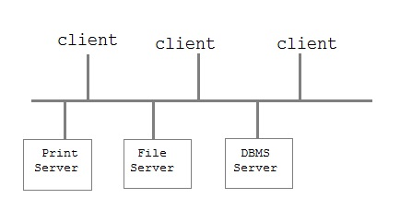
  Two tier client server architecture
If the architecture of DBMS is 2-tier, then it must have an application through which the DBMS can be accessed. Programmers use 2-tier architecture where they access the DBMS by means of an application. Here the application tier is entirely independent of the database in terms of operation, design, and programming.
Is used for user interface programs and application programs that run on client side.

Slide 6
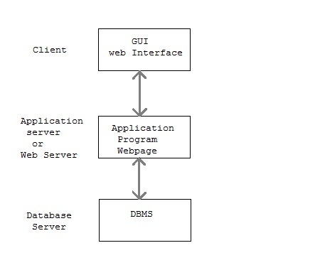
Three tier client server architecture
This is used in web application

Slide 7
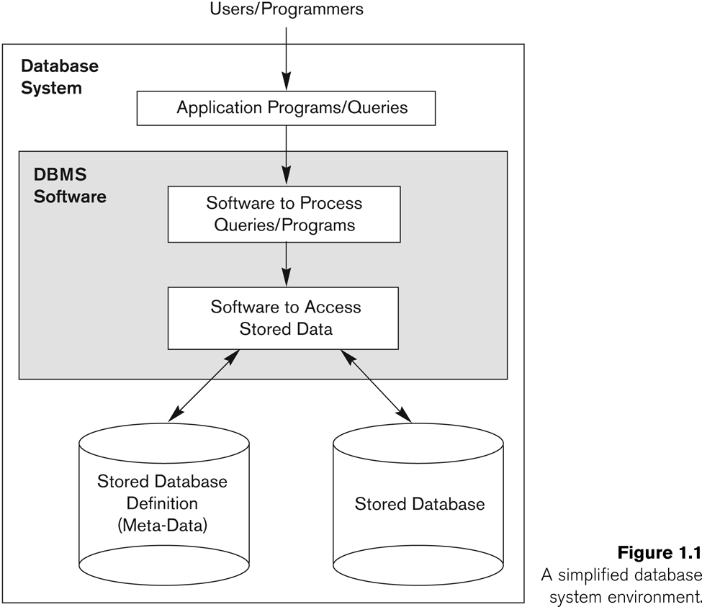
A simplified database system environment

Slide 8
Data Models
Data Model: Data models define how the logical structure of a database is modeled. Data Models are fundamental entities to introduce abstraction in a DBMS. Data models define how data is connected to each other and how they are processed and stored inside the system.
  Many type of data models
  Makes data abstraction possible
    Hides details of physical data storage from the user .
  Most commercial database systems are based on relational data model
Notes:
Structure means data types, relationships, and constraints that always hold for the data

Slide 9
Database (Implementation) Models
Hierarchical
Network
Relational
Object-oriented

Slide 10
Hierarchical Model
Represents a hierarchy with the whole at the root and the components forms the child nodes in turn
Thus, all the components or the nodes, taken together form the whole

Slide 11
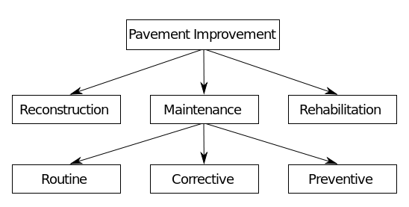
Hierarchical Model

Slide 12
Hierarchical Model Advantages
Conceptual simplicity
Database security
Data independence
Database integrity
Efficiency (more suitable for large volumes of data with 1:M relationships)

Slide 13
Hierarchical Model Disadvantages
Complex implementation. Requires complete knowledge of the hierarchy
Difficult to manage for complex sets of data
Lacks structural independence
Implementation limitations: difficult to implement M: relations

Slide 14
Network Model
Resembles the hierarchical model with a provision for a record to have more than one parent
  An owner record is equivalent to a parent, and a member record s equivalent to a child in the hierarchical model
  The difference is that a record can appear as a member in more than one set

Slide 15
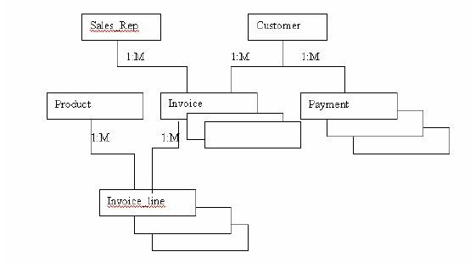
Network Model

Slide 16
Network Model Advantages
Conceptual simplicity
More elations can be handled
Data independence
Database integrity
Data access flexibility

Slide 17
Network Model Disadvantages
Complexity increases with large databases and multiple relation types
Difficult to make structural changes
Database design and update activities require more time

Slide 18
Relational Model
They can manipulate are stored as relations → relational database
Relational database system devised by Codd in 1970
An attempt to devise a standard model with a sound mathematical basis
Most successful & better model than other database model
SQL query language uses for querying the data
Examples include:
  Oracle, Microsoft Access, FoxPro, MySql, SQLServer etc
Notes:
The relational model is different to previous models in that it is based on mathematical set theory which gives it a rigorous structure, as defined above. These rules allow standard use of any system which claims to be relational and has led to their success, and the success of their most used query language SQL. In the next couple of slides we show a simple example relational database and then show some simple queries after introducing briefly SQL, which you will start learning in tutorials.

Slide 19
“Relations”
Can be represented as tables in which rows represent “tuples” and columns represents attributes
A relation may be described by its name and the related attributes
Eg (Employee (Emp_no, Emp_ name, Age, Start_date, Address……. )

Slide 20
Relational Database - Example
BRANCH relation
STAFF relation
Has
Work In
Notes:
This simple example shows two relations (or tables) called branch and
staff. Notice the structure conforms to the rules on the last slide, each table has a probable key value which uniquely identifies each row (branchNo and staffNo), and notice how the two tables can be linked as each table contains the branchNo, so we know for example that Ann Beech and David Ford work in branch B003 which is based in Glasgow. Next, we give a simple definition of SQL, which we will discuss in more detail next week, and then show some very simple queries.

Slide 21
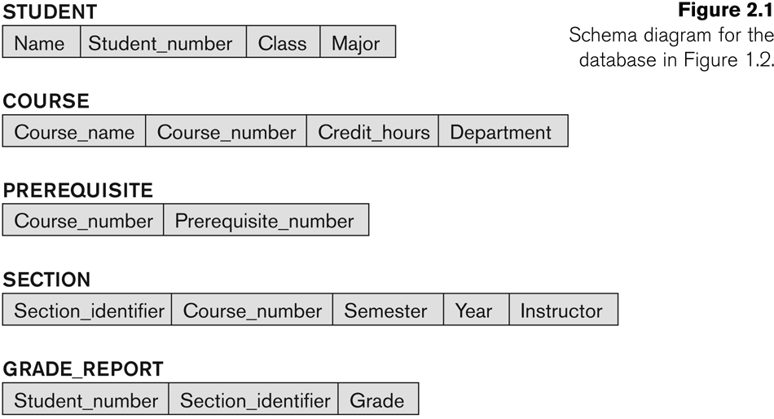
Exists
Has
Has
Has

Slide 22
Features of Relational DBMS
2-D tables (rows and columns representing records/tuples and fields/attributes)
Dynamic links among tables
Easy and flexible to design and use
Data independence
Generic manipulation language (SQL)

Slide 23
Questions?

